Slide 1
Course Plan
CS 331 Programming Languages Lab
Jan-May 2024
Prof. Sukumar Nandi

Slide 2
Course Instructor & TAs
Course Instructor: Prof. Sukumar Nandi
PhD TAs:
Manoj Das (mdas@iitg.ac.in)
Saurav Gupta (g.saurav@iitg.ac.in)
Saurav Kumar (ksaurav@iitg.ac.in)
M.Tech TAs:
Hriman Krishna Mahanta (m.hriman@iitg.ac.in)
Tanigundala Venkata Sai Sri Ram (r.tanigundala@iitg.ac.in)
Rahul Bhanudas Agarkar (r.agarkar@iitg.ac.in)
Rumit Pingleshwar Gore(g.rumit@iitg.ac.in)
Akshay Sitaram Bhosale (a.bhosale@iitg.ac.in)

Slide 3
Moodle Page
Link: https://www.iitg.ac.in/moodle/course/view.php?id=922
Password: CS331STUDENT
All course materials, assignments, and other important documents will be shared on Moodle.

Slide 4
Marks Distribution
Weightages:
Tutorials: 40%
Lab: 60%

Slide 5
Evaluation Structure - Tutorials
1 Tutorial Class Every Tuesday
Classroom: 5001
Timings: 2:00 pm – 2:55 pm 2 Quizzes in Total
Quiz 1: February
Quiz 2: April

Slide 6
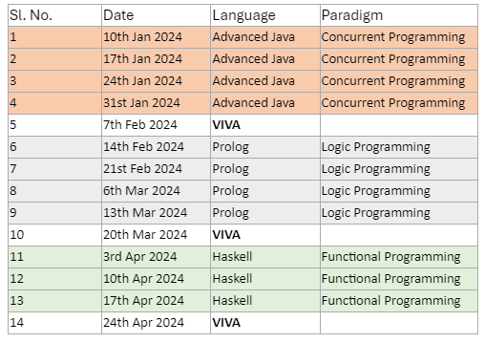
Evaluation Structure - Lab
Lab-Based Continuous Evaluation, Attendance in Lab is mandatory.

Slide 7
Lab Evaluation – Points to Note
A student will be assigned a question in a random manner.
The question will be mailed to each student individually at the start of the lab.
He is expected to solve the question within the lab hours and upload it on Moodle to be eligible for full marks.
If a student is not able to solve within the stipulated time, a grace period will be provided with a certain deduction in marks.
No form of plagiarism will be allowed, either from the internet or from any other student.
The evaluating TA will assess the program and upload the marks and his comments on Moodle.
He may ask you questions on your program to assess your understanding of the concepts.

Slide 8
CS 331 Syllabus
Prerequisites: CS101,CS110,CS203,CS204
Syllabus: Programming paradigms: imperative and declarative (introduction); Concurrent programming: basic idea, Java language introduction, concurrent programming with Java (threads and libraries); Logic programming: basic idea, Prolog introduction, logic programming with Prolog; Functional programming: basic idea, introduction to LISP/Haskell, functional programming with LIST/Haskell

Slide 9
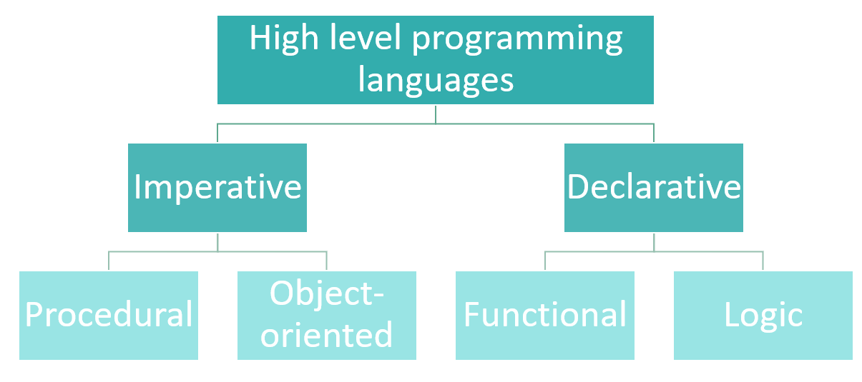
Programming Paradigms

Slide 10
CS 331 References
Web references:
https://docs.oracle.com/javase/tutorial/
http://www.learnyouahaskell.com/
https://www.tutorialspoint.com/lisp/index.htm
http://www.learnprolognow.org/lpnpage.php?pageid=online
Goetz, B. et al. Java concurrency in practice, Pearson 2006.
Blackburn, Patrick, Johannes Bos, and Kristina Striegnitz. Learn prolog now!, Vol. 7. No. 7. Londres: College Publications, 2006.
Hutton, G. Programming in Haskell, Cambridge University Press, 2016.

